Slide 1
Formative Assessment Day 3-Session 4

Slide 2
Session Outcomes
1. Clarify the relationship between teaching, learning and outcomes
2. To understand the meaning and differences between;
Assessment for learning
Assessment of learning
Assessment as learning
3. Apply the formative assessment in your work

Slide 3
Formative Assessment
Brainstorm about these questions
What do you assess?
Why do you assess?
How do you assess?
When do you assess?
Where do you assess?
Whom do you assess?
What do you do after the assessment?

Slide 4
KEY POINTS
Formative Assessment
Many scholars agreed that it was an ideal way of molding a competent product of the learning process (Bloom, Hastings and Madduas, 1971)
It’s a range of formal and informal assessment procedures conducted by teachers during the learning process in order to modify teaching and learning activities so as to improve the learners attainments.
It has a number of types, forms / branches.

Slide 5
Activity 1 (10 minutes)
In your group;
Explain the term Assessment
2. Discuss the meaning of the terms ;
a) assessment for learning
b) assessment of learning
c) assessment as learning

Slide 6
KEY POINTS
Assessment
Refers to a wide variety of tools that educators use to measure and document academic readiness, learning progress, skills acquisition or education needs of learners.
Assessment for learning
This is an approach to teaching and learning that creates feedback which is then used to improve students performance.
Assessment for learning involves a continuous ways of checks and balances in the teaching and the learning process.

Slide 7
Purpose of Assessment for learning (AfL)
Enables teachers to determine next steps in advancing the student learning process.
Provides each learner with accurate formal /informal feedback to further his learning.
Helps learners to understand their own learning progress.
Deeply involves learners in peer and self assessment in course of teaching and learning.

Slide 8
Purpose of AfL cont’d……
Allows teachers to frequently check their learners' progress as well as the effectiveness of their own practice.
Encourages the classroom culture of interaction between teachers and learners using the assessment tools.
Builds learners skills of learning to learn.

Slide 9
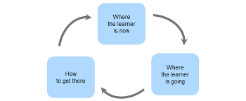
Methodology

Slide 10
Assessment of learning
These are strategies designed to confirm what students know, demonstrate whether they have met the intended learning outcomes and to certify the level of their attainments.
It is a way to see what the students can do after a certain level of studying.
Its an assessment that becomes public.

Slide 11
Purpose for Assessment of learning
To gather relevant information about student performance and progress plans.
To determine student interests, to make judgments about their learning Records.
Its Summative usually done at the end of a task, project, unit of work etc.
Assessment of learning is commonly done for education accountability.

Slide 12
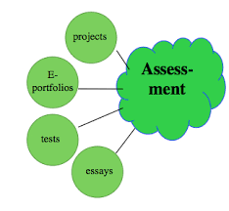
Methodology

Slide 13
Assessment as learning
This is where learners use the individual self-assessment (or assessment by peers) to monitor their own learning progress.
Its characterized by students reflecting on their own learning, taking records and making adjustments so that they achieve deeper understanding.

Slide 14
Purpose of assessment as learning
Building confidence
Academic self actualization
For self esteem and motivation
For reflection and monitoring of self progress
Use of readily accessible knowledge
For self judgment and adjustments

Slide 15


Methodology

Slide 16
Purpose of Formative Assessment in the CBC
Learning experiences are constructed to develop KUSVA, so learning progress should be systematically monitored to obtain the desired outcome through answering the following questions
What students know (now)
What should be done (next)
What should they be (destination)

Slide 17
Formative Assessment Strategies
Support Strategy | Category
Observation of learners during the learning activities | Observation of actions, talks, attitudes
Self assessment by learners | Conversation
Peer feedback | Conversation
Use of questioning | Conversation
Effective teacher feedback | Conversation
Formative use summative assessment | Product evaluation of the output at the of a specific cycle

Slide 18
Take home
Using your subject syllabus,
Select one learning outcome from any of the topics
2. Identify ways in which you can perform
Assessment for learning
Assessment as learning
Assessment of learning

Slide 19
Activity 3 (10 min)
In groups;
Use the available resources within the workshop room to produce a ball that can be used to play safely
Document your procedure on a chart for display.
Score your ball on the scale of 1-5
Now exchange the ball with another group to score you.

Slide 20
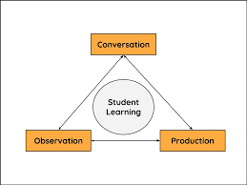
Triangulation
It’s a form of assessment method that involves the teacher collecting evidence from three different sources i.e
Observation
Conversation
Product

Slide 21
Activity 4
In your groups
Check in your respective syllabus books and pick out a learning activity that demonstrates triangulation.
Prepare this and present to plenary.

Slide 22
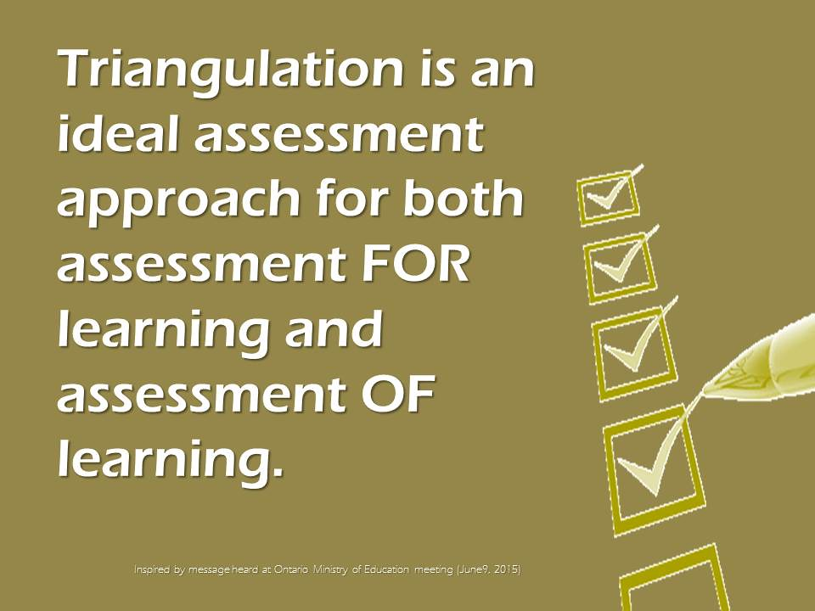
Application of Triangulation

Slide 23
Take Home
In groups ;
Find out the challenges affecting the above 3 forms of school based formative assessments.
Suggest their solutions.
Present your findings.

Slide 24
THANK YOU

